Slide 1
Syntax Analyzer

Slide 2
THE ROLE OF THE PARSER
In our compiler model, the parser obtains a string of tokens from the lexical analyzer.
It verifies that the string of token names can be generated by the grammar for the source language.
The parser report any syntax errors in an intelligible fashion and to recover from commonly occurring errors to continue processing the remainder of the program.
Conceptually, for well-formed programs, the parser constructs a parse tree and passes it to the rest of the compiler for further processing.

Slide 3
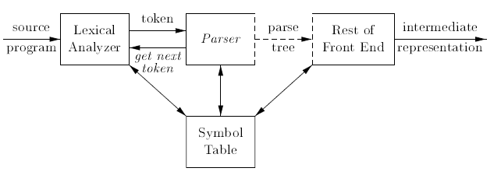
THE ROLE OF THE PARSER

Slide 4
Types of Parser
There are three general types of parsers for grammars: universal, top-down, and bottom-up.
Universal parsing methods such as the Cocke-Younger-Kasami algorithm and Earley's algorithm can parse any grammar.
These general methods are, however, too inefficient to use in production compilers.
Top-down methods build parse trees from the top (root) to the bottom (leaves), while bottom-up methods start from the leaves and work their way up to the root.

Slide 5
Programming Errors
Lexical errors include misspellings of identifiers, keywords, or operators
Syntactic errors include misplaced semicolons or extra or missing braces; that is, “{" or \}”. As another example, in C or Java, the appearance of a case statement without an enclosing switch is a syntactic error
Semantic errors include type mismatches between operators and operands, e.g., the return of a value in a Java method with result type void.
Logical errors can be anything from incorrect reasoning on the part of the programmer to the use in a C program of the assignment operator =instead of the comparison operator ==.

Slide 6
Role of error handler in a parser
Report the presence of errors clearly and accurately.
Recover from each error quickly enough to detect subsequent errors.
Add minimal overhead to the processing of correct programs.

Slide 7
Error-Recovery Strategies
Panic Mode Recovery
Phrase level
Error productions
Global correction

Slide 8
Panic Mode Recovery
With this method, on discovering an error, the parser discards input symbols one at a time until one of a designated set of synchronizing tokens is found.
The synchronizing tokens are usually delimiters, such as semicolon or }, whose role in the source program is clear and unambiguous.
The compiler designer must select the synchronizing tokens appropriate for the source language.
While panic-mode correction often skips a considerable amount of input without checking it for additional errors, it has the advantage of simplicity, and, unlike some methods to be considered later, is guaranteed not to go into an infinite loop.

Slide 9
Phrase Level
On discovering an error, a parser may perform local correction on the remaining input; that is, it may replace a prefix of the remaining input by some string that allows the parser to continue.
A typical local correction would be to replace a comma by a semicolon, delete an extraneous semicolon, or insert a missing semicolon.
Be careful while choosing the replacements that do not lead to infinite loops, as would be the case, for example, if we always inserted something on the input ahead of the current input symbol.
This type of replacement can correct any input string and has been used in several error-repairing compilers. The method was first used with top-down parsing. Its major drawback is the difficulty it has in coping with situations in which the actual error has occurred before the point of detection.

Slide 10
Error Productions
If we have a good idea of the common errors that might be encountered, we can augment the grammar for the language at hand with productions that generate the erroneous constructs
We then use the grammar augmented by these error productions to construct a parser
If an error production is used by the parser, we can generate appropriate error diagnostics to indicate the erroneous construct that has been recognized in the input.

Slide 11
Global Corrections
Ideally, we would like a compiler to make as few changes as possible in processing an incorrect input string.
There are algorithms for choosing a minimal sequence of changes to obtain a globally least-cost correction.
Given an incorrect input string x and grammar G, these algorithms will find a parse tree for a related string y, such that the number of insertions, deletions, and changes of tokens required to transform x into y is as small as possible.
These methods are in general too costly to implement in terms of time and space so these are of theoretical aspects.

Slide 12
CONTEXT-FREE GRAMMARS
Systematically describe the syntax of programming language constructs like expressions and statements
Terminals are the basic symbols from which strings are formed. The terminals are the keywords if , then and else.
Nonterminals are syntactic variables that denote sets of strings. Stmt and Expr are nonterminals .The nonterminals define sets of strings that help define the language generated by the grammar. They also impose a hierarchical structure on the language that is useful for Both syntax analysis and translation.

Slide 13
In a grammar, one nonterminal is distinguished as the start symbol, and the set of strings it denotes is the language defined by the grammar.
The productions of a grammar specify the manner in which the terminals and nonterminals can be combined to form strings. Each production consists of a nonterminal followed by an arrow, followed by a string of nonterminals and terminals.

Slide 14

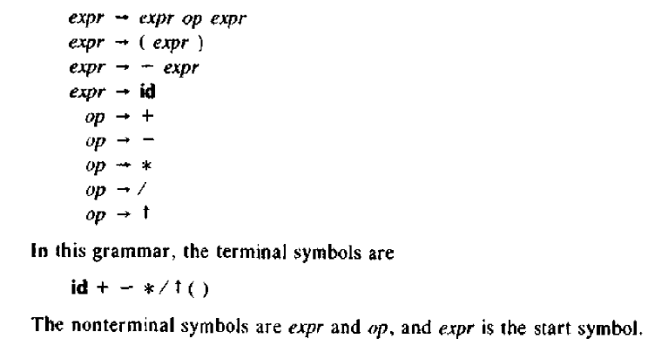

Slide 15
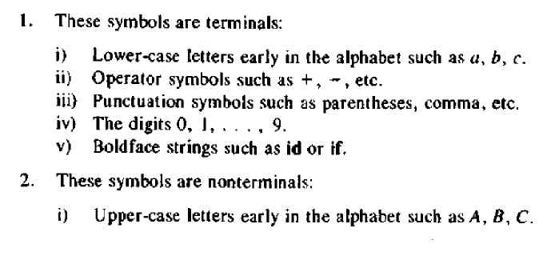

Notational Conventions

Slide 16
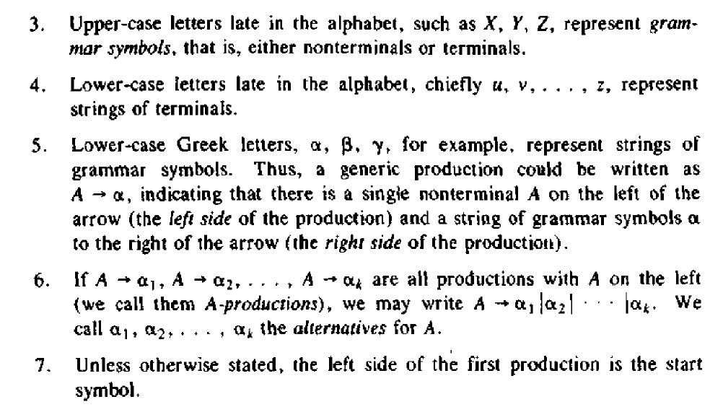

Slide 17

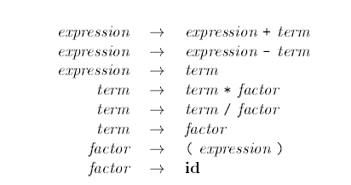

Slide 18



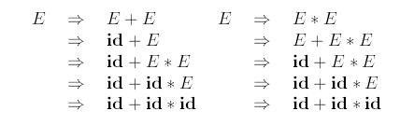
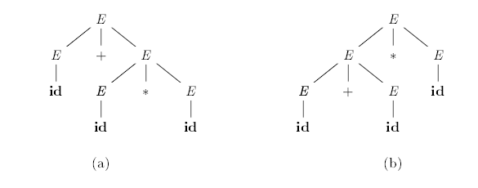
We could write the previous grammar as
For the below grammar we have two derivations ie. Leftmost derivation and rightmost derivation for the string

Slide 19


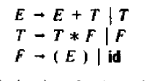
Elimination of Left Recursion
If we have left recursive grammar like
Then after elimination of left recursion the grammar will having following production.

Slide 20
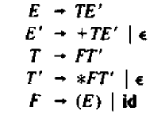


If we have these production like
Then after removal of left recursion the grammar will be

Slide 21


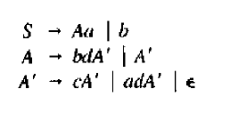
Consider the grammar
After removal of left recursion the final grammar will be obtained as

Slide 22
Left recursion elimination (cont.)
There are cases like following
S -> Aa | b
A -> Ac | Sd | ɛ
Left recursion elimination algorithm:
Arrange the nonterminals in some order A1,A2,…,An.
For (each i from 1 to n) {
For (each j from 1 to i-1) {
Replace each production of the form Ai-> Aj γ by the production Ai -> δ1 γ | δ2 γ | … |δk γ where Aj-> δ1 | δ2 | … |δk are all current Aj productions
}
Eliminate left recursion among the Ai-productions
}

Slide 23
Left factoring
Left factoring is a grammar transformation that is useful for producing a grammar suitable for predictive or top-down parsing.
Consider following grammar:
Stmt -> if expr then stmt else stmt
| if expr then stmt
On seeing input if it is not clear for the parser which production to use
We can easily perform left factoring:
If we have A->αβ1 | αβ2 then we replace it with
A -> αA’
A’ -> β1 | β2

Slide 24



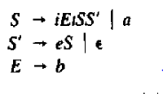
Left Factoring
left-factored, the original productions become
If we have another production like

Slide 25

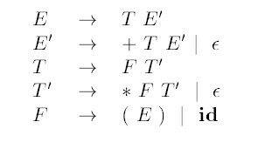
TOP-DOWN PARSING
Top-down parsing can be viewed as an attempt to find a leftmost derivation for an input string.
It can be viewed as an attempt to construct a parse tree for the input starring from the root and creating the nodes of the parse tree in preorder.
For the input string
By using the following grammar the construction of top down parser is shown on next slide.

Slide 26
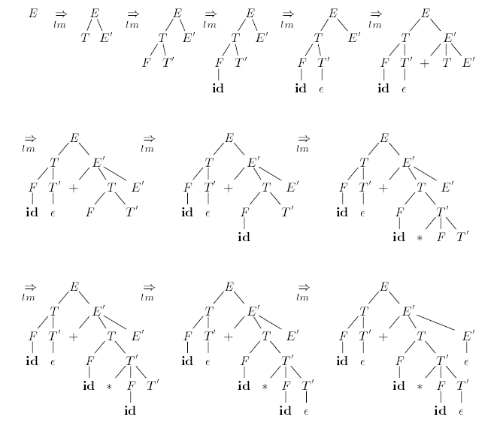


Slide 27
First and Follow
First() is set of terminals that begins strings derived from
If α=>ɛ then is also in First(ɛ)
In predictive parsing when we have A-> α|β, if First(α) and First(β) are disjoint sets then we can select appropriate A-production by looking at the next input
Follow(A), for any nonterminal A, is set of terminals a that can appear immediately after A in some sentential form
If we have S => αAaβ for some αand βthen a is in Follow(A)
If A can be the rightmost symbol in some sentential form, then $ is in Follow(A)
*
*

Slide 28
Computing First
To compute First(X) for all grammar symbols X, apply following rules until no more terminals or ɛ can be added to any First set:
If X is a terminal then First(X) = {X}.
If X is a nonterminal and X->Y1Y2…Yk is a production for some k>=1, then place a in First(X) if for some i a is in First(Yi) and ɛ is in all of First(Y1),…,First(Yi-1) that is Y1…Yi-1 => ɛ. if ɛ is in First(Yj) for j=1,…,k then add ɛ to First(X).
If X-> ɛ is a production then add ɛ to First(X)
Example!
*
*

Slide 29
Computing follow
To compute First(A) for all nonterminals A, apply following rules until nothing can be added to any follow set:
Place $ in Follow(S) where S is the start symbol
If there is a production A-> αBβ then everything in First(β) except ɛ is in Follow(B).
If there is a production A->B or a production A->αBβ where First(β) contains ɛ, then everything in Follow(A) is in Follow(B)
Example!

Slide 30
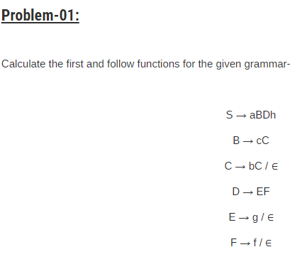

Slide 31
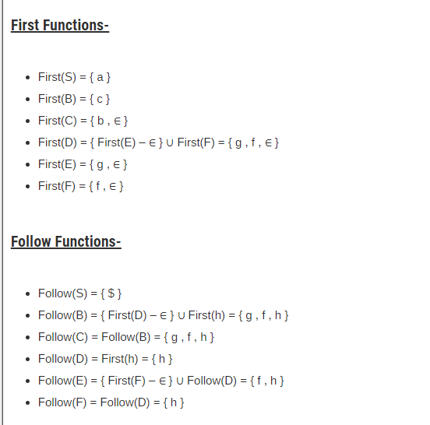

Slide 32
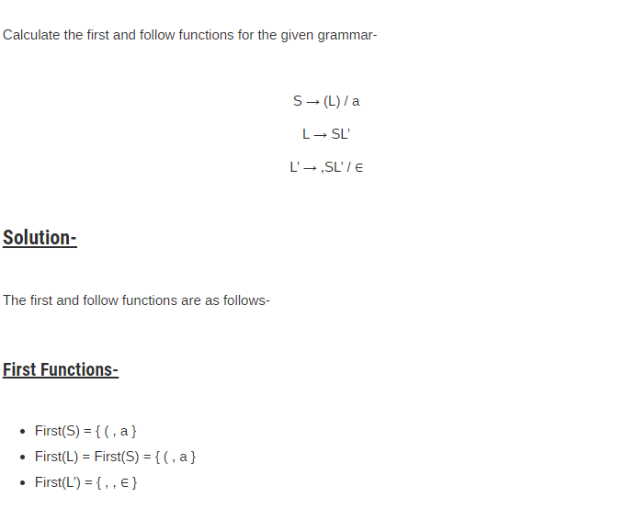

Slide 33
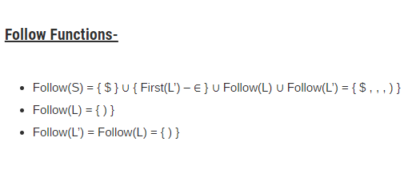

Slide 34
LL(1) Grammars
Predictive parsers are those recursive descent parsers needing no backtracking
Grammars for which we can create predictive parsers are called LL(1)
The first L means scanning input from left to right
The second L means leftmost derivation
And 1 stands for using one input symbol for lookahead
A grammar G is LL(1) if and only if whenever A-> α|βare two distinct productions of G, the following conditions hold:
For no terminal a do αandβ both derive strings beginning with a
At most one of α or βcan derive empty string
If α=> ɛ then βdoes not derive any string beginning with a terminal in Follow(A).
*

Slide 35
Construction of predictive parsing table
For each production A->α in grammar do the following:
For each terminal a in First(α) add A-> in M[A,a]
If ɛ is in First(α), then for each terminal b in Follow(A) add A-> ɛ to M[A,b]. If ɛ is in First(α) and $ is in Follow(A), add A-> ɛ to M[A,$] as well
If after performing the above, there is no production in M[A,a] then set M[A,a] to error

Slide 36
Example
First
Follow
F
T
E
E’
T’
{(,id}
{+, *, ), $}
E -> TE’
E’ -> +TE’ | Ɛ
T -> FT’
T’ -> *FT’ | Ɛ
F -> (E) | id
{(,id}
{+, ), $}
{(,id}
{), $}
{+,ɛ}
{), $}
{*,ɛ}
{+, ), $}
Input Symbol
Non -
terminal
id
+
*
(
)
$
E
E’
T
T’
F
E -> TE’
E -> TE’
E’ -> +TE’
E’ -> Ɛ
E’ -> Ɛ
T -> FT’
T -> FT’
T’ -> Ɛ
T’ -> *FT’
T’ -> Ɛ
T’ -> Ɛ
F -> id
F -> (E)

Slide 37
Another example
S -> iEtSS’ | a
S’ -> eS | Ɛ
E -> b
Input Symbol
Non -
terminal
a
b
e
i
t
$
S
S’
E
S -> a
S -> iEtSS’
S’ -> Ɛ
S’ -> eS
S’ -> Ɛ
E -> b

Slide 38
Non-recursive predicting parsing
a
+
b
$
Predictive
parsing
program
output
stack
X
Y
Z
$
Parsing
Table
M

Slide 39
Predictive parsing algorithm
Set ip point to the first symbol of w;
Set X to the top stack symbol;
While (X<>$) { /* stack is not empty */
if (X is a) pop the stack and advance ip;
else if (X is a terminal) error();
else if (M[X,a] is an error entry) error();
else if (M[X,a] = X->Y1Y2..Yk) {
output the production X->Y1Y2..Yk;
pop the stack;
push Yk,…,Y2,Y1 on to the stack with Y1 on top;
}
set X to the top stack symbol;
}

Slide 40
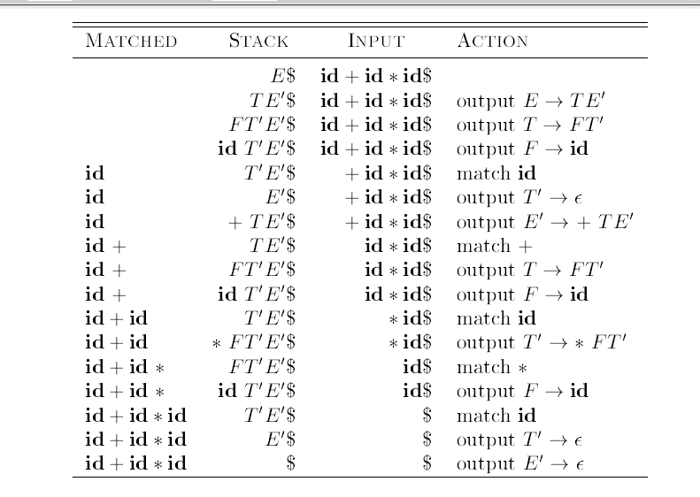

Slide 41
Example
id+id*id$
Matched
Stack
Input
Action
E$
id+id*id$

Slide 42
Error recovery in predictive parsing
Panic mode
Place all symbols in Follow(A) into synchronization set for nonterminal A: skip tokens until an element of Follow(A) is seen and pop A from stack.
Add to the synchronization set of lower level construct the symbols that begin higher level constructs
Add symbols in First(A) to the synchronization set of nonterminal A
If a nonterminal can generate the empty string then the production deriving can be used as a default
If a terminal on top of the stack cannot be matched, pop the terminal, issue a message saying that the terminal was inserted

Slide 43
Example
Non -
terminal
Input Symbol
id
+
*
(
)
$
E
E’
T
T’
F
E -> TE’
E -> TE’
synch
synch
E’ -> +TE’
E’ -> Ɛ
E’ -> Ɛ
T -> FT’
synch
T -> FT’
synch
synch
T’ -> Ɛ
T’ -> *FT’
T’ -> Ɛ
T’ -> Ɛ
F -> id
synch
synch
F -> (E)
synch
synch
Stack
Input
Action
E$
)id*+id$
Error, Skip )
E$
id*+id$
id is in First(E)
TE’$
id*+id$
FT’E’$
id*+id$
idT’E’$
id*+id$
T’E’$
*+id$
*FT’E’$
*+id$
FT’E’$
+id$
Error, M[F,+]=synch
T’E’$
+id$
F has been poped

Slide 44
Bottom-up Parsing

Slide 45
Introduction
Constructs parse tree for an input string beginning at the leaves (the bottom) and working towards the root (the top)
Example: id*id
E -> E + T | T
T -> T * F | F
F -> (E) | id
F
E
id*id
F * id
T * id
T * F
id
F
F
id
T * F
F
id
id
F
id
T * F
id
F
id
id

Slide 46
Shift-reduce parser
The general idea is to shift some symbols of input to the stack until a reduction can be applied
At each reduction step, a specific substring matching the body of a production is replaced by the nonterminal at the head of the production
The key decisions during bottom-up parsing are about when to reduce and about what production to apply
A reduction is a reverse of a step in a derivation
The goal of a bottom-up parser is to construct a derivation in reverse:
E=>T=>T*F=>T*id=>F*id=>id*id

Slide 47
Handle pruning
A Handle is a substring that matches the body of a production and whose reduction represents one step along the reverse of a rightmost derivation
Right sentential form
Handle
Reducing production
id*id
id
F->id
F*id
F
T->F
T*id
id
F->id
T*F
T*F
E->T*F

Slide 48
Shift reduce parsing
A stack is used to hold grammar symbols
Handle always appear on top of the stack
Initial configuration:
Stack Input
$ w$
Acceptance configuration
Stack Input
$S $

Slide 49
Shift reduce parsing (cont.)
Basic operations:
Shift
Reduce
Accept
Error
Example: id*id
Stack
Input
Action
$
id*id$
shift
$id
*id$
reduce by F->id
$F
*id$
reduce by T->F
$T
*id$
shift
$T*
id$
shift
$T*id
$
reduce by F->id
$T*F
$
reduce by T->T*F
$T
$
reduce by E->T
$E
$
accept

Slide 50
Handle will appear on top of the stack
S
S
A
B
B
A
α
β
γ
z
α
γ
z
y
x
y
Stack
Input
Stack
Input
$αβγ
yz$
$αγ
xyz$
$αβB
yz$
$αBxy
z$
$αβBy
z$

Slide 51

Conflicts during shit reduce parsing
Two kind of conflicts
Shift/reduce conflict
Reduce/reduce conflict
Example:
Stack
Input
… if expr then stmt
else …$

Slide 52
Reduce/reduce conflict
stmt -> id(parameter_list)
stmt -> expr:=expr
parameter_list->parameter_list, parameter
parameter_list->parameter
parameter->id
expr->id(expr_list)
expr->id
expr_list->expr_list, expr
expr_list->expr
Stack
Input
… id(id
,id) …$

Slide 53
LR Parsing
The most prevalent type of bottom-up parsers
LR(k), mostly interested on parsers with k<=1
Why LR parsers?
Table driven
Can be constructed to recognize all programming language constructs
Most general non-backtracking shift-reduce parsing method
Can detect a syntactic error as soon as it is possible to do so
Class of grammars for which we can construct LR parsers are superset of those which we can construct LL parsers

Slide 54
States of an LR parser
States represent set of items
An LR(0) item of G is a production of G with the dot at some position of the body:
For A->XYZ we have following items
A->.XYZ
A->X.YZ
A->XY.Z
A->XYZ.
In a state having A->.XYZ we hope to see a string derivable from XYZ next on the input.
What about A->X.YZ?

Slide 55
Constructing canonical LR(0) item sets
Augmented grammar:
G with addition of a production: S’->S
Closure of item sets:
If I is a set of items, closure(I) is a set of items constructed from I by the following rules:
Add every item in I to closure(I)
If A->α.Bβ is in closure(I) and B->γ is a production then add the item B->.γ to clsoure(I).
Example:
I0=closure({[E’->.E]}
E’->.E
E->.E+T
E->.T
T->.T*F
T->.F
F->.(E)
F->.id
E’->E
E -> E + T | T
T -> T * F | F
F -> (E) | id

Slide 56
Constructing canonical LR(0) item sets (cont.)
Goto (I,X) where I is an item set and X is a grammar symbol is closure of set of all items [A-> αX. β] where [A-> α.X β] is in I
Example
I1
E’->E.
E->E.+T
E
I0=closure({[E’->.E]}
E’->.E
E->.E+T
E->.T
T->.T*F
T->.F
F->.(E)
F->.id
T
I2
E’->T.
T->T.*F
(
I4
F->(.E)
E->.E+T
E->.T
T->.T*F
T->.F
F->.(E)
F->.id

Slide 57
Closure algorithm
SetOfItems CLOSURE(I) {
J=I;
repeat
for (each item A-> α.Bβ in J)
for (each prodcution B->γ of G)
if (B->.γ is not in J)
add B->.γ to J;
until no more items are added to J on one round;
return J;

Slide 58
GOTO algorithm
SetOfItems GOTO(I,X) {
J=empty;
if (A-> α.X β is in I)
add CLOSURE(A-> αX. β ) to J;
return J;
}

Slide 59
Canonical LR(0) items
Void items(G’) {
C= CLOSURE({[S’->.S]});
repeat
for (each set of items I in C)
for (each grammar symbol X)
if (GOTO(I,X) is not empty and not in C)
add GOTO(I,X) to C;
until no new set of items are added to C on a round;
}

Slide 60
Example
E’->E
E -> E + T | T
T -> T * F | F
F -> (E) | id
acc
$
I6
E->E+.T
T->.T*F
T->.F
F->.(E)
F->.id
I9
E->E+T.
T->T.*F
I1
E’->E.
E->E.+T
T
+
E
I0=closure({[E’->.E]}
E’->.E
E->.E+T
E->.T
T->.T*F
T->.F
F->.(E)
F->.id
T
I2
E’->T.
T->T.*F
I7
T->T*.F
F->.(E)
F->.id
F
I10
T->T*F.
*
id
id
I5
F->id.
(
+
I4
F->(.E)
E->.E+T
E->.T
T->.T*F
T->.F
F->.(E)
F->.id
E
I8
E->E.+T
F->(E.)
)
I11
F->(E).
I3
T>F.

Slide 61
Use of LR(0) automaton
Example: id*id
Line | Stack | Symbols | Input | Action
(1) | 0 | $ | id*id$ | Shift to 5
(2) | 05 | $id | *id$ | Reduce by F->id
(3) | 03 | $F | *id$ | Reduce by T->F
(4) | 02 | $T | *id$ | Shift to 7
(5) | 027 | $T* | id$ | Shift to 5
(6) | 0275 | $T*id | $ | Reduce by F->id
(7) | 02710 | $T*F | $ | Reduce by T->T*F
(8) | 02 | $T | $ | Reduce by E->T
(9) | 01 | $E | $ | accept

Slide 62
LR-Parsing model
INPUT
a1 | … | ai | … | an | $
LR Parsing Program
Output
Sm
Sm-1
…
$
ACTION | GOTO

Slide 63
LR parsing algorithm
let a be the first symbol of w$;
while(1) { /*repeat forever */
let s be the state on top of the stack;
if (ACTION[s,a] = shift t) {
push t onto the stack;
let a be the next input symbol;
} else if (ACTION[s,a] = reduce A->β) {
pop |β| symbols of the stack;
let state t now be on top of the stack;
push GOTO[t,A] onto the stack;
output the production A->β;
} else if (ACTION[s,a]=accept) break; /* parsing is done */
else call error-recovery routine;
}

Slide 64
Example
(0) E’->E
(1) E -> E + T
(2) E-> T
(3) T -> T * F
(4) T-> F
(5) F -> (E)
(6) F->id
STATE | ACTON |  |  |  |  |  | GOTO
 | id | + | * | ( | ) | $ | E | T | F
0 | S5 |  |  | S4 |  |  | 1 | 2 | 3
1 |  | S6 |  |  |  | Acc
2 |  | R2 | S7 |  | R2 | R2
3 |  | R4 | R7 |  | R4 | R4
4 | S5 |  |  | S4 |  |  | 8 | 2 | 3
5 |  | R6 | R6 |  | R6 | R6
6 | S5 |  |  | S4 |  |  |  | 9 | 3
7 | S5 |  |  | S4 |  |  |  |  | 10
8 |  | S6 |  |  | S11
9 |  | R1 | S7 |  | R1 | R1
10 |  | R3 | R3 |  | R3 | R3
11 |  | R5 | R5 |  | R5 | R5
id*id+id?
Line | Stack | Symbols | Input | Action
(1) | 0 |  | id*id+id$ | Shift to 5
(2) | 05 | id | *id+id$ | Reduce by F->id
(3) | 03 | F | *id+id$ | Reduce by T->F
(4) | 02 | T | *id+id$ | Shift to 7
(5) | 027 | T* | id+id$ | Shift to 5
(6) | 0275 | T*id | +id$ | Reduce by F->id
(7) | 02710 | T*F | +id$ | Reduce by T->T*F
(8) | 02 | T | +id$ | Reduce by E->T
(9) | 01 | E | +id$ | Shift
(10) | 016 | E+ | id$ | Shift
(11) | 0165 | E+id | $ | Reduce by F->id
(12) | 0163 | E+F | $ | Reduce by T->F
(13) | 0169 | E+T` | $ | Reduce by E->E+T
(14) | 01 | E | $ | accept

Slide 65
Constructing SLR parsing table
Method
Construct C={I0,I1, … , In}, the collection of LR(0) items for G’
State i is constructed from state Ii:
If [A->α.aβ] is in Ii and Goto(Ii,a)=Ij, then set ACTION[i,a] to “shift j”
If [A->α.] is in Ii, then set ACTION[i,a] to “reduce A->α” for all a in follow(A)
If {S’->.S] is in Ii, then set ACTION[I,$] to “Accept”
If any conflicts appears then we say that the grammar is not SLR(1).
If GOTO(Ii,A) = Ij then GOTO[i,A]=j
All entries not defined by above rules are made “error”
The initial state of the parser is the one constructed from the set of items containing [S’->.S]

Slide 66
Example grammar which is not SLR(1)
S -> L=R | R
L -> *R | id
R -> L
I0
S’->.S
S -> .L=R
S->.R
L -> .*R |
L->.id
R ->. L
I1
S’->S.
I3
S ->R.
I5
L -> id.
I7
L -> *R.
I2
S ->L.=R
R ->L.
I4
L->*.R
R->.L
L->.*R
L->.id
I6
S->L=.R
R->.L
L->.*R
L->.id
I8
R -> L.
I9
S -> L=R.
Action
=
2
Shift 6
Reduce R->L

Slide 67
More powerful LR parsers
Canonical-LR or just LR method
Use lookahead symbols for items: LR(1) items
Results in a large collection of items
LALR: lookaheads are introduced in LR(0) items

Slide 68
Canonical LR(1) items
In LR(1) items each item is in the form: [A->α.β,a]
An LR(1) item [A->α.β,a] is valid for a viable prefix γ if there is a derivation S=>δAw=>δαβw, where
Γ= δα
Either a is the first symbol of w, or w is ε and a is $
Example:
S->BB
B->aB|b
*
rm
*
S=>aaBab=>aaaBab
rm
Item [B->a.B,a] is valid for γ=aaa
and w=ab

Slide 69
Constructing LR(1) sets of items
SetOfItems Closure(I) {
repeat
for (each item [A->α.Bβ,a] in I)
for (each production B->γ in G’)
for (each terminal b in First(βa))
add [B->.γ, b] to set I;
until no more items are added to I;
return I;
}
SetOfItems Goto(I,X) {
initialize J to be the empty set;
for (each item [A->α.Xβ,a] in I)
add item [A->αX.β,a] to set J;
return closure(J);
}
void items(G’){
initialize C to Closure({[S’->.S,$]});
repeat
for (each set of items I in C)
for (each grammar symbol X)
if (Goto(I,X) is not empty and not in C)
add Goto(I,X) to C;
until no new sets of items are added to C;
}

Slide 70
Example
S’->S
S->CC
C->cC
C->d

Slide 71
Canonical LR(1) parsing table
Method
Construct C={I0,I1, … , In}, the collection of LR(1) items for G’
State i is constructed from state Ii:
If [A->α.aβ, b] is in Ii and Goto(Ii,a)=Ij, then set ACTION[i,a] to “shift j”
If [A->α., a] is in Ii, then set ACTION[i,a] to “reduce A->α”
If {S’->.S,$] is in Ii, then set ACTION[I,$] to “Accept”
If any conflicts appears then we say that the grammar is not LR(1).
If GOTO(Ii,A) = Ij then GOTO[i,A]=j
All entries not defined by above rules are made “error”
The initial state of the parser is the one constructed from the set of items containing [S’->.S,$]

Slide 72
Example
S’->S
S->CC
C->cC
C->d

Slide 73
LALR Parsing Table
For the previous example we had:
I4
C->d. , c/d
I47
C->d. , c/d/$
I7
C->d. , $
State merges cant produce Shift-Reduce conflicts. Why?
But it may produce reduce-reduce conflict

Slide 74
Example of RR conflict in state merging
S’->S
S -> aAd | bBd | aBe | bAe
A -> c
B -> c

Slide 75
An easy but space-consuming LALR table construction
Method:
Construct C={I0,I1,…,In} the collection of LR(1) items.
For each core among the set of LR(1) items, find all sets having that core, and replace these sets by their union.
Let C’={J0,J1,…,Jm} be the resulting sets. The parsing actions for state i, is constructed from Ji as before. If there is a conflict grammar is not LALR(1).
If J is the union of one or more sets of LR(1) items, that is J = I1 UI2…IIk then the cores of Goto(I1,X), …, Goto(Ik,X) are the same and is a state like K, then we set Goto(J,X) =k.

Slide 76
Compaction of LR parsing table
Many rows of action tables are identical
Store those rows separately and have pointers to them from different states
Make lists of (terminal-symbol, action) for each state
Implement Goto table by having a link list for each nonterinal in the form (current state, next state)

Slide 77
Using ambiguous grammars
STATE | ACTON |  |  |  |  |  | GOTO
 | id | + | * | ( | ) | $ | E
0 | S3 |  |  | S2 |  |  | 1
1 |  | S4 | S5 |  |  | Acc
2 | S3 |  | S2 |  |  |  | 6
3 |  | R4 | R4 |  | R4 | R4
4 | S3 |  |  | S2 |  |  | 7
5 | S3 |  |  | S2 |  |  | 8
6 |  | S4 | S5
7 |  | R1 | S5 |  | R1 | R1
8 |  | R2 | R2 |  | R2 | R2
9 |  | R3 | R3 |  | R3 | R3
E->E+E
E->E*E
E->(E)
E->id
I0: E’->.E
E->.E+E
E->.E*E
E->.(E)
E->.id
I1: E’->E.
E->E.+E
E->E.*E
I2: E->(.E)
E->.E+E
E->.E*E
E->.(E)
E->.id
I4: E->E+.E
E->.E+E
E->.E*E
E->.(E)
E->.id
I5: E->E*.E
E->(.E)
E->.E+E
E->.E*E
E->.(E)
E->.id
I6: E->(E.)
E->E.+E
E->E.*E
I7: E->E+E.
E->E.+E
E->E.*E
I3: E->.id
I8: E->E*E.
E->E.+E
E->E.*E
I9: E->(E).

